Slide 1
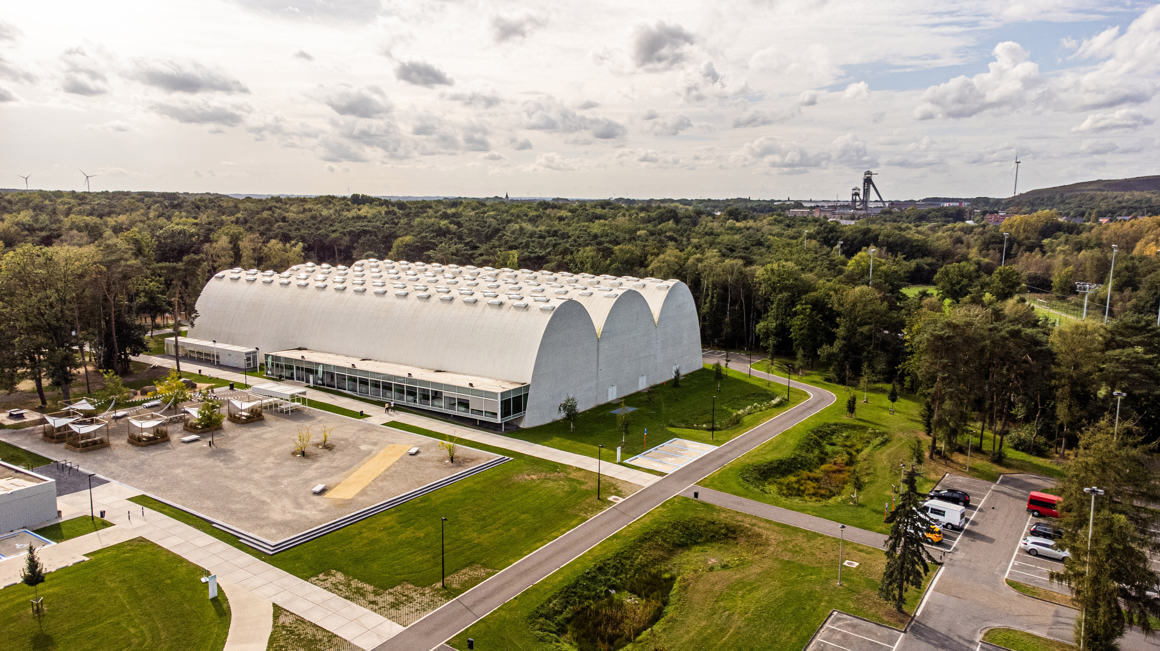

Mini- Atomiade 2026
5 - 8 June 2026
Genk - Belgium

Slide 2
Mini- Atomiade 2026: SPORTS
Small field football
Golf
Tennis
Padel
Volleybal
Run (probably 5 km and 10 km)
Mountainbike (distance TBD)
Archery
Petanque
Badminton
Hike (no competition)

Slide 3
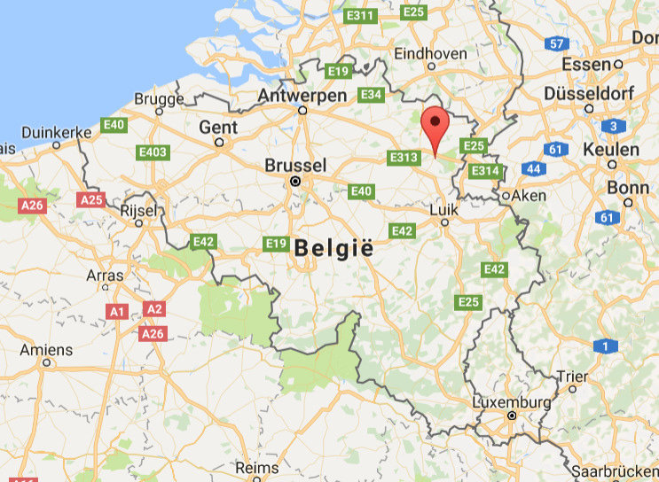
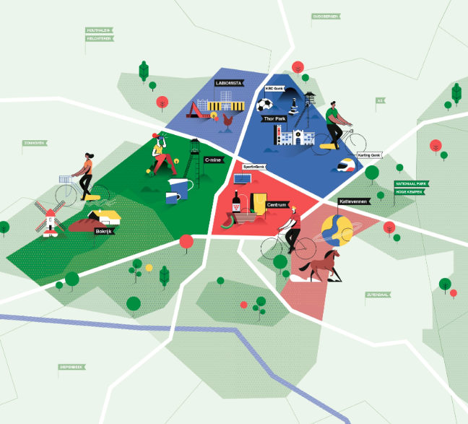
Mini- Atomiade 2026: LOCATIONS
GENK
THOR Park
Evenings
SportinGenk Park
Football, Volleybal, Badminton
TC Winterslag
Tennis, Padel
Spiegelven Golfclub
Golf
Kattevennen
Run, Mountainbike, Archery, Hike
PC Genk
Pétanque

Slide 4
Mini- Atomiade 2026: PRACTICAL
Teams: subscibe your teams per sport as soon as possible
This will allow us to arrange all sport fields
Start of individual registration: November 2025
End of registration: January 2026
Hotels: via VISIT GENK
Discounts will be available from: October 2025
Price: 250€ (incl. sports, 2x lunch and 3x dinner)
Extra fees: hotels + breakfast, green fee + trolleys golf, bike rental, …

Slide 5
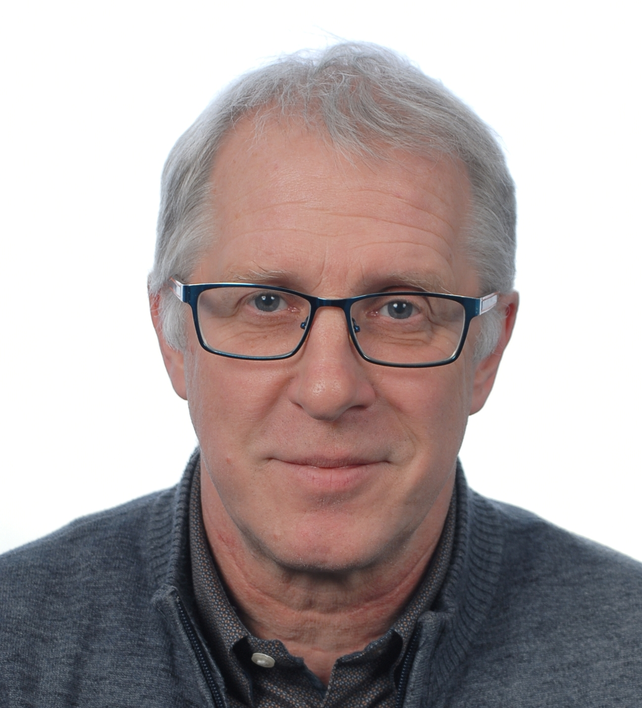
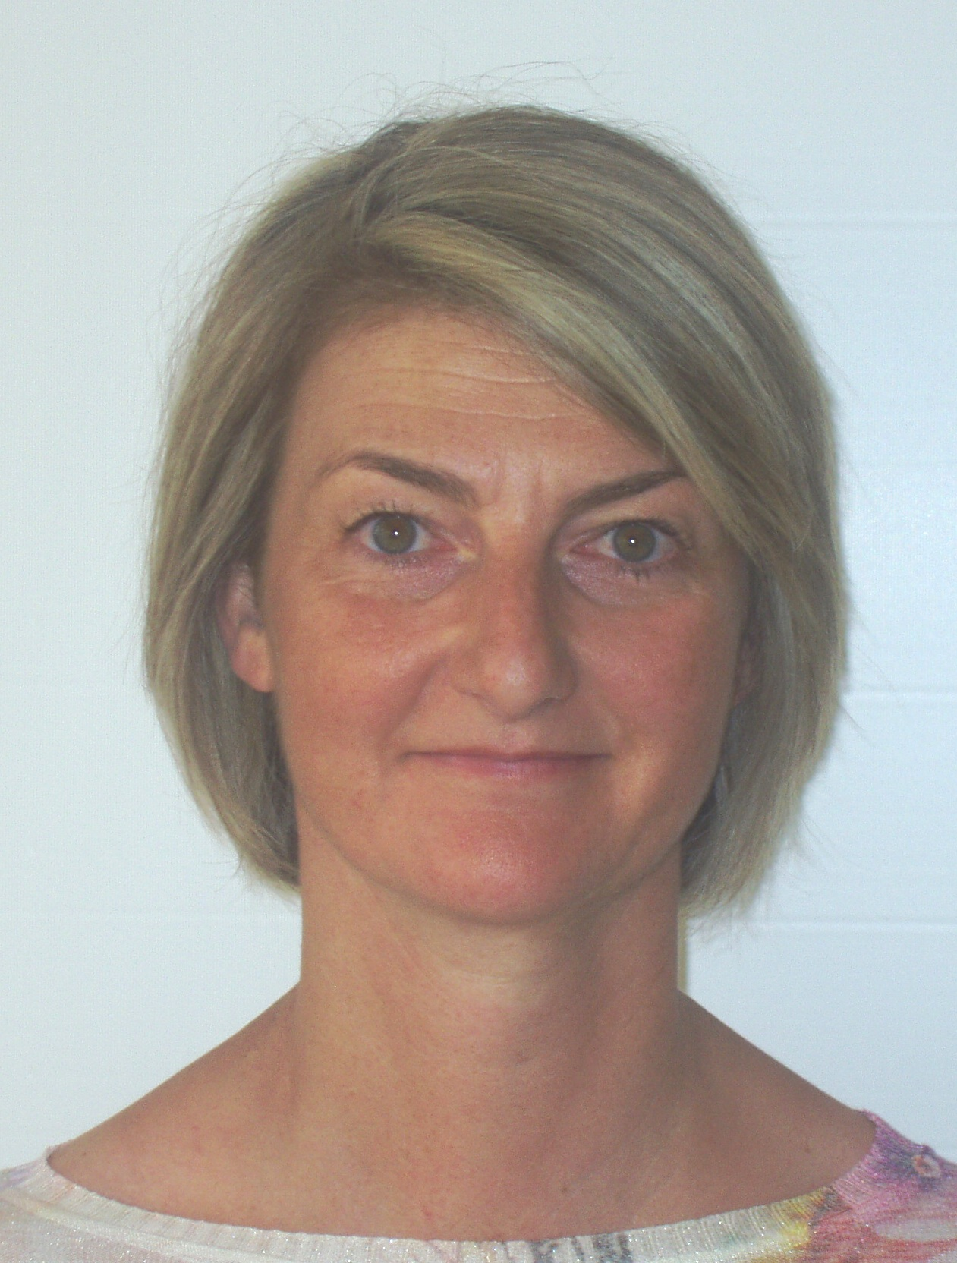
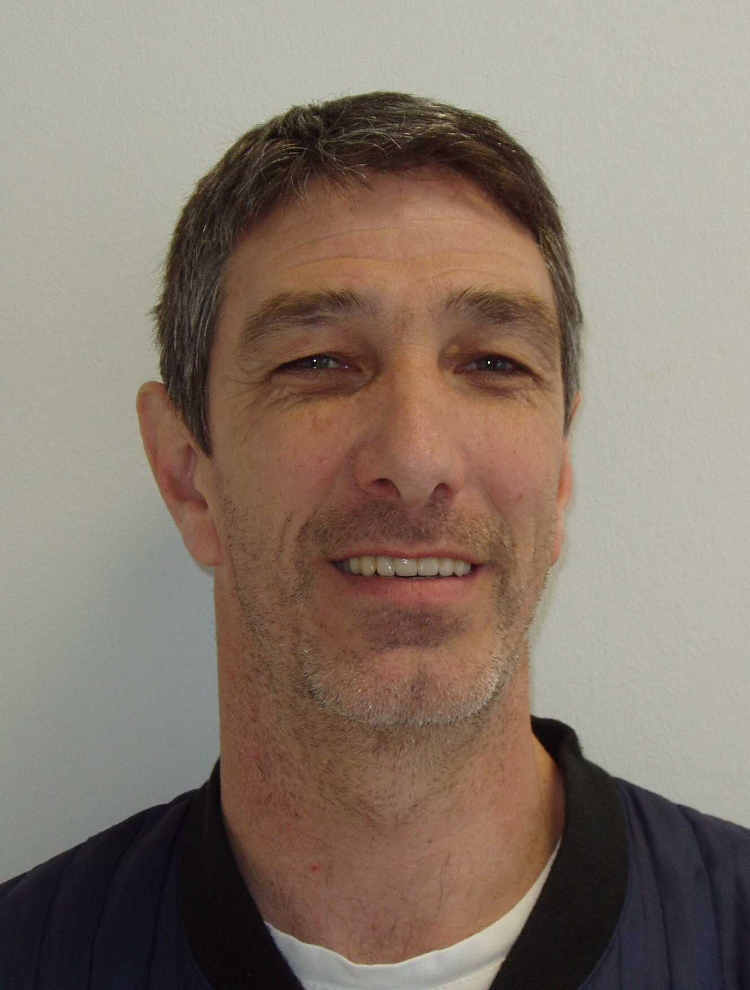
Mini- Atomiade 2026: MAIN CONTACTS
Danny Millen Tina Caeyers Tom Geubbelmans
Atomiade2026@belgoprocess.be

