Slide 1
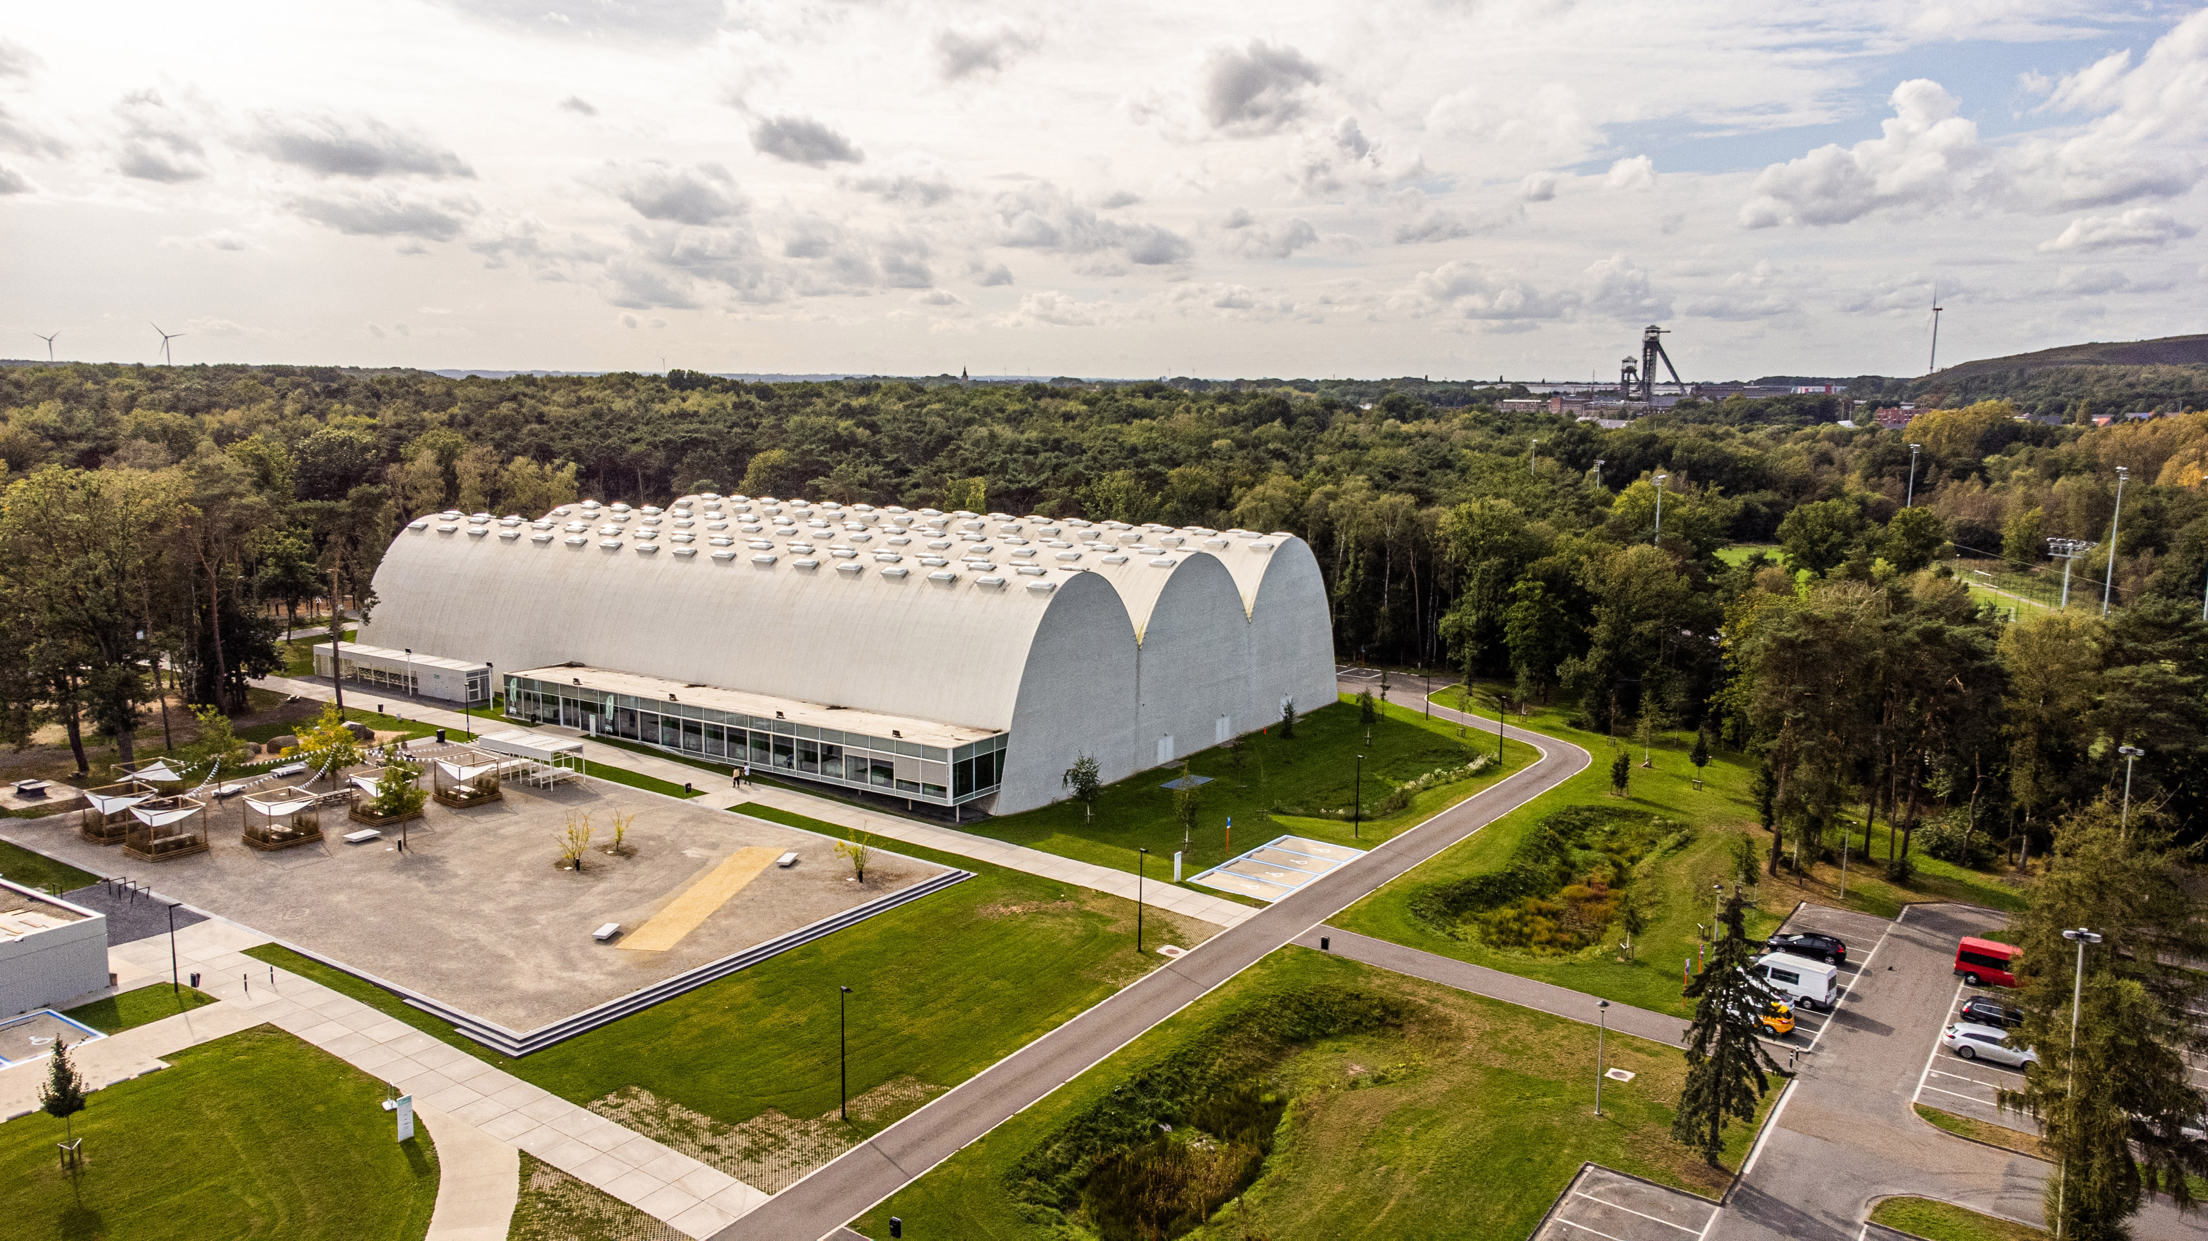

Mini- Atomiade 2026
6 and 7 June 2026
Genk - Belgium

